Slide 1
成績分佈
Avg: 63 Max: 96

Slide 2
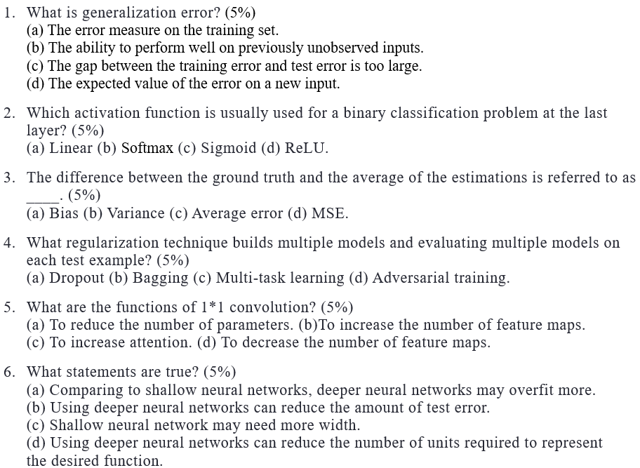
d
c
a
b
bd
bcd

Slide 3
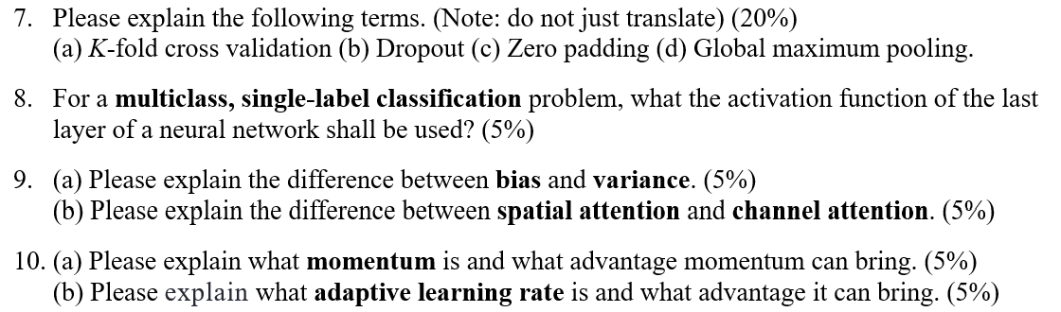

Slide 4
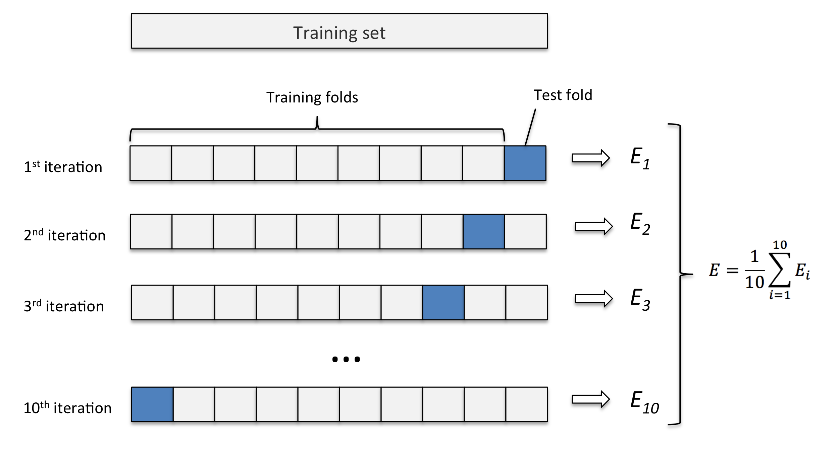
K-Fold Cross-Validation
The most common way to negotiate this trade-off is to use cross-validation.
Empirically, cross-validation is highly successful on many real-world tasks.
A partition of the dataset is formed by splitting it into k non-overlapping subsets.
The test error may then be estimated by taking the average test error across k trials.

Slide 5
Dropout
For a base network with two visible units and two hidden units, there are sixteen possible subsets of these four units.
In this small example, a large proportion of the resulting networks have no input units or no path connecting the input to the output.
This problem becomes insignificant for networks with wider layers, where the probability of dropping all possible paths from inputs to outputs becomes smaller.

Slide 6
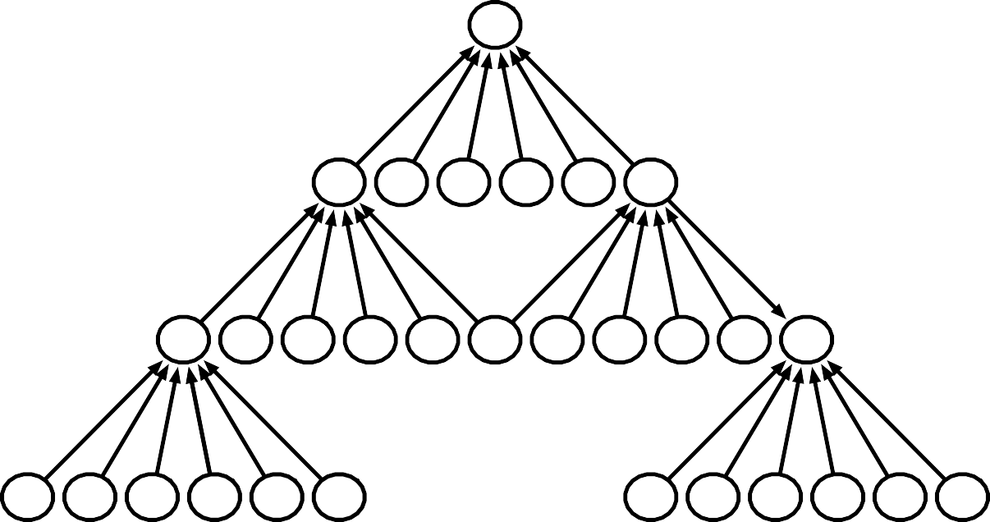
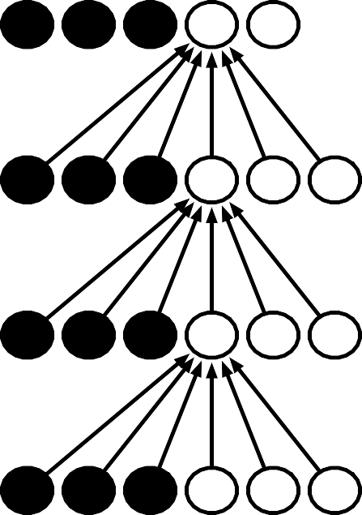
Zero Padding Controls Size
-5 units
With zero padding
(the output size will be the same)
-5 units
...
-5 units
...
...
...
...
...
...
Without zero padding
(kernel size: 6)
...
...
(Top) We do not use any implicit zero padding. This causes the representation to shrink by five pixels at each layer. Starting from an input of sixteen pixels, we are only able to have three convolutional layers, and the last layer does not ever move the kernel, so arguably only two of the layers are truly convolutional. The rate of shrinking can be mitigated by using smaller kernels, but smaller kernels are less expressive and some shrinking is inevitable in this kind of architecture.
(Bottom) By adding five implicit zeroes to each layer, we prevent the representation from shrinking with depth. This allows us to make an arbitrarily deep convolutional network.

Slide 7
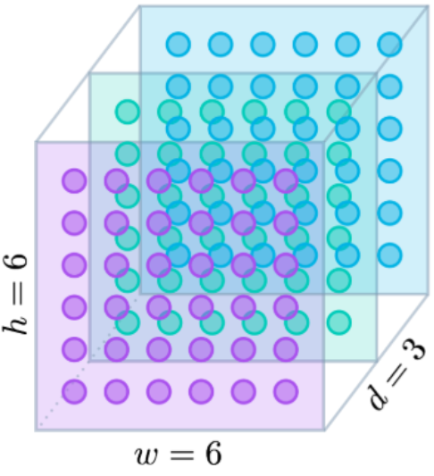
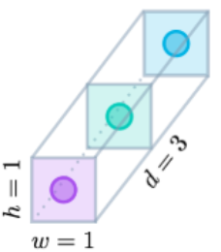
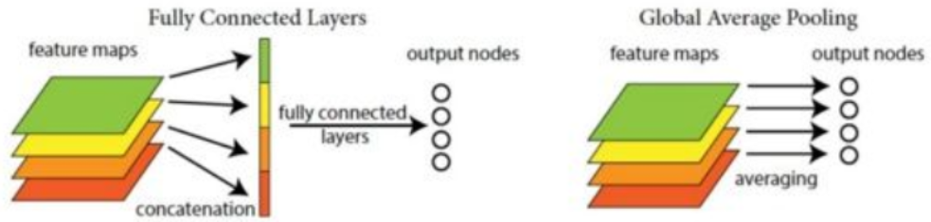
Global Average Pooling (GAP)
Global Maximum Pooling
Reduce parameters and overfitting

Slide 8
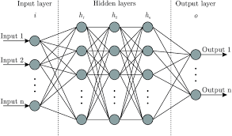
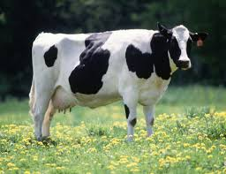
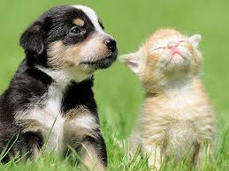
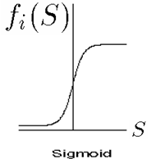
Output Types
Problem Type | Last-layer Activation | Cost/Loss Function | Example
Binary classification | Sigmoid | Binary cross-entropy | Yes/no problems
Multiclass, single-label classification | Softmax | Categorical cross-entropy | Single object recognition
Multiclass, multilabel classification | Sigmoid | Binary cross-entropy | Multi object detection
Regression to arbitrary values | None | Mean squared error (MSE) | Stock price prediction
Regression to values between 0 and 1 | Sigmoid | MSE or binary cross-entropy
1
Cow
Cat
…
…
Dog
Is this a cow?
What is it?
What are they?

Slide 9
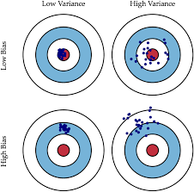

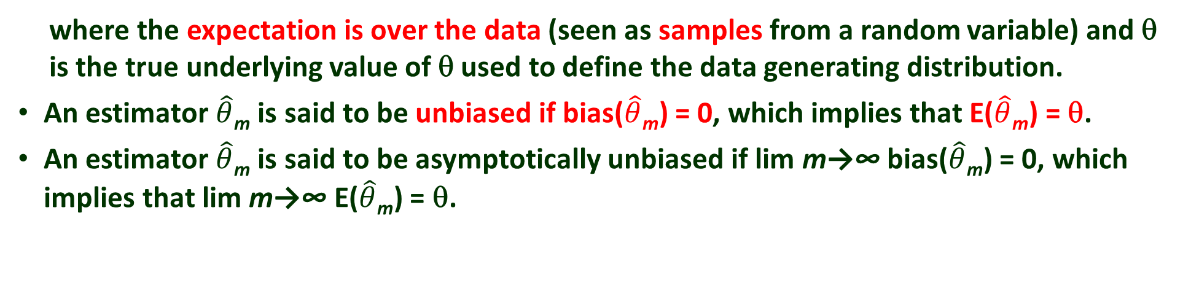
Bias and Variance
Bias and variance measure two different sources of error in an estimator
The bias of an estimator is defined as:
where the expectation is over the data (seen as samples from a random variable) and θ is the true underlying value of θ used to define the data generating distribution.
An estimator $\hat{θ}$_{m} is said to be unbiased if bias($\hat{θ}$_{m}) = 0, which implies that E($\hat{θ}$_{m}) = θ.
An estimator $\hat{θ}$_{m} is said to be asymptotically unbiased if lim m→∞ bias($\hat{θ}$_{m}) = 0, which implies that lim m→∞ E($\hat{θ}$_{m}) = θ.

Slide 10
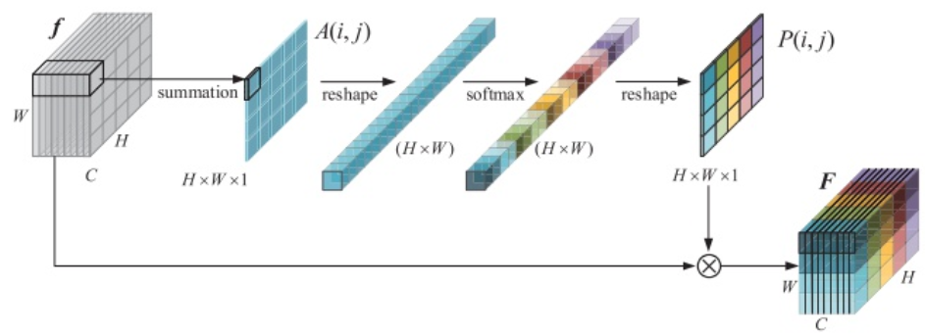
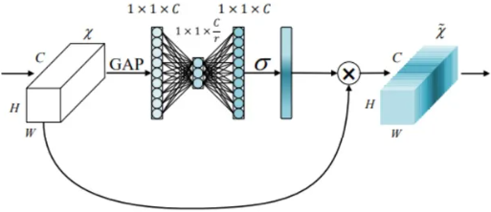
Spatial Attention
Which areas in a map are more important?
(0~1)
or
average
Channel Attention
Which channels are more important?
Global average pooling (GAP)
Global max pooling

Slide 11
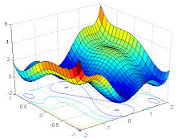
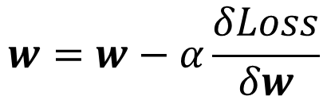
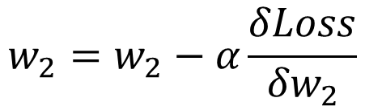

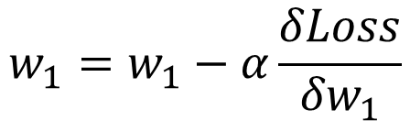


Problems:
Some regions are flat and some are steep.
In a region, some direction is flat and some is steep.
$$Loss$$
$$w=w−α\frac{δLoss}{δw}$$
$$w_{1}=w_{1}−α\frac{δLoss}{{δw}_{1}}$$
$$w_{2}=w_{2}−α\frac{δLoss}{{δw}_{2}}$$
$$w_{1}$$
Solutions:
Include momentum
Adaptive learning rates
$$w_{2}$$

Slide 12
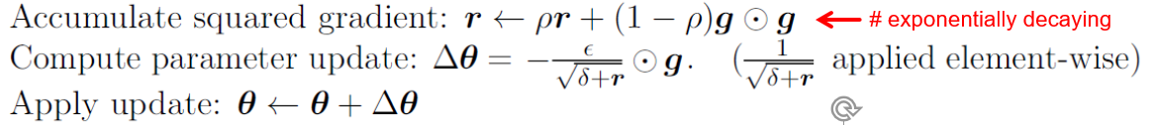
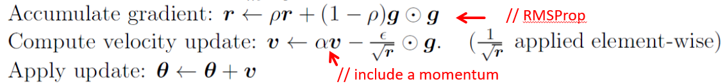
RMSProp + Momentum
RMSProp is shown in its standard form in algorithm 8.5 and combined with Nesterov momentum in algorithm 8.6.
Compared to AdaGrad, the use of the moving average introduces a new hyperparameter, ρ, that controls the length scale of the moving average.
Empirically, RMSProp has been shown to be an effective and practical optimization algorithm for deep neural networks.
It is currently one of the go-to optimization methods being employed routinely by deep learning practitioners.

Slide 13
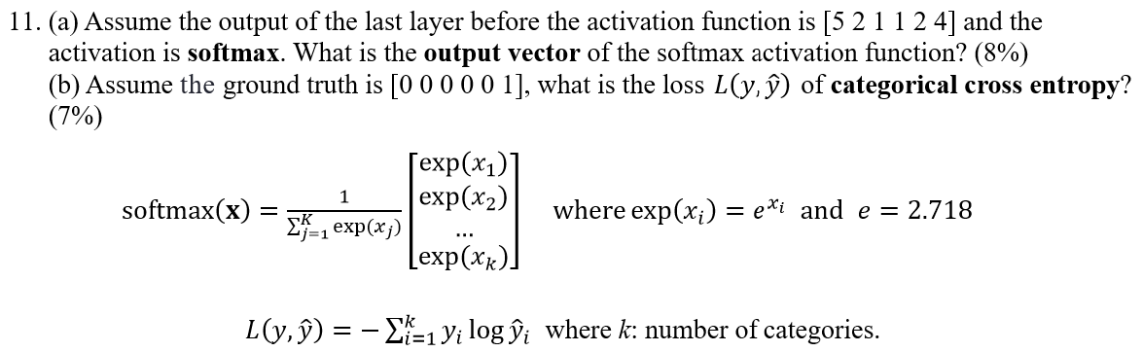
223
[148 7.4 2.7 2.7 7.4 54.8]^{T}
a. [0.665 0.033 0.012 0.012 0.033 0.245]^{T}
b. -(1*log0.245) = 0.612

Slide 14
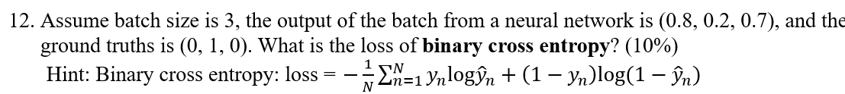
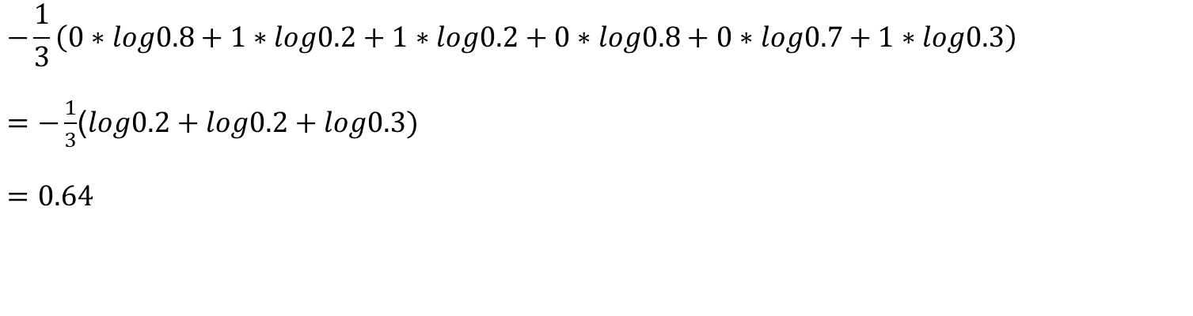
$$−\frac{1}{3}\left(0∗log0.8+1∗log0.2+1∗log0.2+0∗log0.8+0∗log0.7+1∗log0.3\right)$$
$=−\frac{1}{3}$($log0.2+log0.2+log0.3)$
$$=0.64$$

